Slide 1
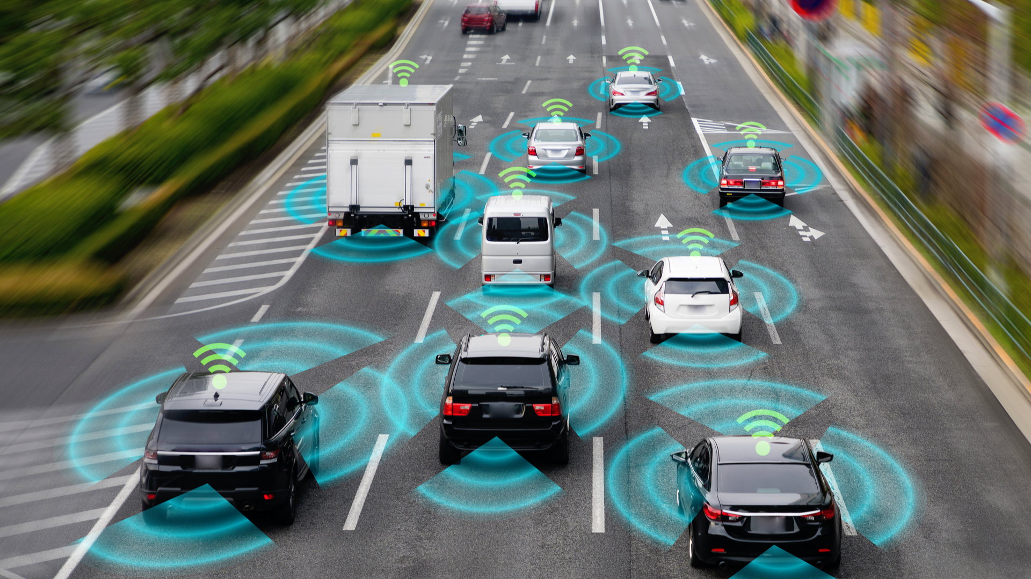


Mobile Application for Intelligent Transportation Systems with Vehicular Communications Integration
Student:
Supervisor
Co-supervisor
Collaborator
Gil Teixeira - gilteixeira@ua.pt - 88194
José Fonseca – jaf@ua.pt
João Almeida - jmpa@ua.pt
Emanuel Vieira - Vieira.e@ua.pt
Dissertation
12th July 2024, Aveiro
Notes:
Good morning. My name is [name]. I’m here to present my dissertation which is about a [title]

Slide 2
Outline
Introduction
Architecture
Implementation
Evaluation / Results
Conclusions
Publications and Contributions
Notes:
I’ll start with a quick introduction to key concepts as well as the motivation and objectives of this dissertation. I’ll then talk about the architecture and implementation of the mobile application. Next I’ll present the evaluation methods used and the results obtained. Finally I’ll go through the conclusions and the publications and contributions of this work.

Slide 3
Outline
Introduction
Motivation
C-ITS
Objectives
State of the art
Architecture
Implementation
Evaluation / Results
Conclusions
Publications and Contributions
Notes:
First I’ll talk about the motivation for this dissertation, the fundamental concepts of C-ITS, the objectives and finally a features comparison of the state of the art mobile applications.

Slide 4
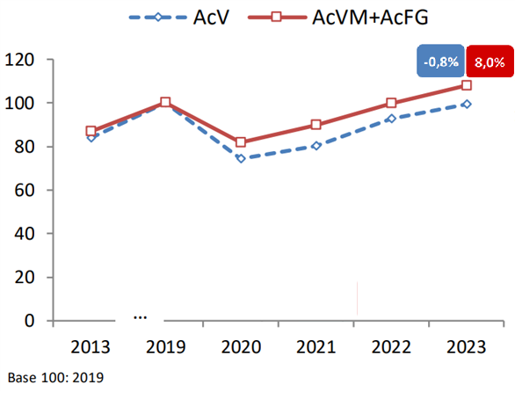
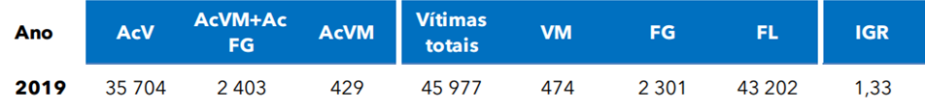
Motivation
+1.6M vehicles in circulation
Nearly constant population
Road accidents
Safety measures haven’t been very effective
Road congestion
Base 100: 2019
. Evolution of accident rates, in mainland Portugal, ANSR
Notes:
In Portugal, since 2013 (over 10 years ago), there’s been an increase of 1.6M vehicles in circulation while the population has been nearly constant.
The graph on the right is the [img label] where the blue line represents accidents with victims and the red represents accidents with fatalities and serious injuries. The values haven’t changed much since 2013 even though there have been many attemps at enhancing road safety.
Road congestion is also a natural consequence of the increase of vehicles in circulation.

Slide 5
C-ITS (Cooperative Intelligent Transportation Systems)
A subset of ITS focused on vehicular communications
Direct communications
Contextually relevant informations
Significantly reduced delay
Standardization of road safety messages (CAM, CPM, VAM, …)
Vehicle-To-Everything (V2X) services
Tolling
Electric Vehicle (EV) charging
C-ITS
Notes:
An ITS represents an environment where road users and infrastructure (its-stations) share real time information about themselves and their surroundings to a central information broker. C-ITS is a subset of ITS focused on vehicular communications (V2X). The Exchange of information is done directly which only includes contextually relevant information and drastically decreases the delay of the communications, essential in preventing accidents. Stations also forward, for some time, the messages received to increase the reach of them. V2X services are advertised by the infastructure and forwarded in the same way and include tolling and ev charging.

Slide 6
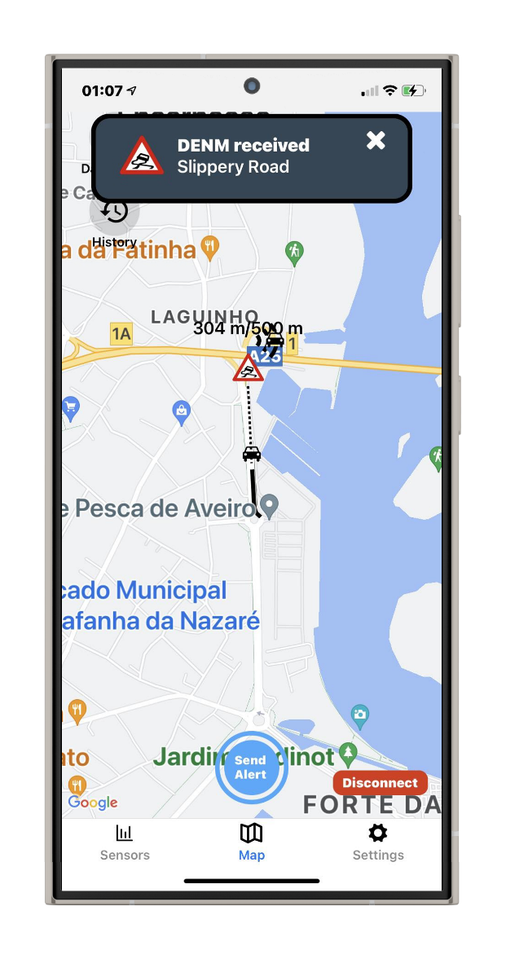
Objectives
Multi-platform mobile application
Interaction with ITS and C-ITS environments
Monitoring
Road users
Infrastructure
Road and weather event creation
VRU location sharing
Interface with V2X services
Sensor data collection

Slide 7
State of the Art
Notes:
The rows are the most popular navigation applications and the columns are features the application aims to have.
Google Maps supports road and weather events and make this information available to developers through paid APIs
Traffic Spotter also supports road and weather events but the data isn’t accessible outsider the app.
Kapsch is the only one that is using standardized ETSI messages and supports V2X to integrate into their C-ITS env (also closed)
C-ITS is a korean application, not available anymore, that claimed to integrate road and weather events, tolling and obd2 Reading, using a proprietary reader.

Slide 8
Outline
Introduction
Architecture
C-ITS
User modes
Mobile Application
Implementation
Evaluation / Results
Conclusions
Publications and Contributions
Notes:
First I’ll talk about the motivation for this dissertation, the fundamental concepts of C-ITS, the objectives and finally a features comparison of the state of the art mobile applications.

Slide 9
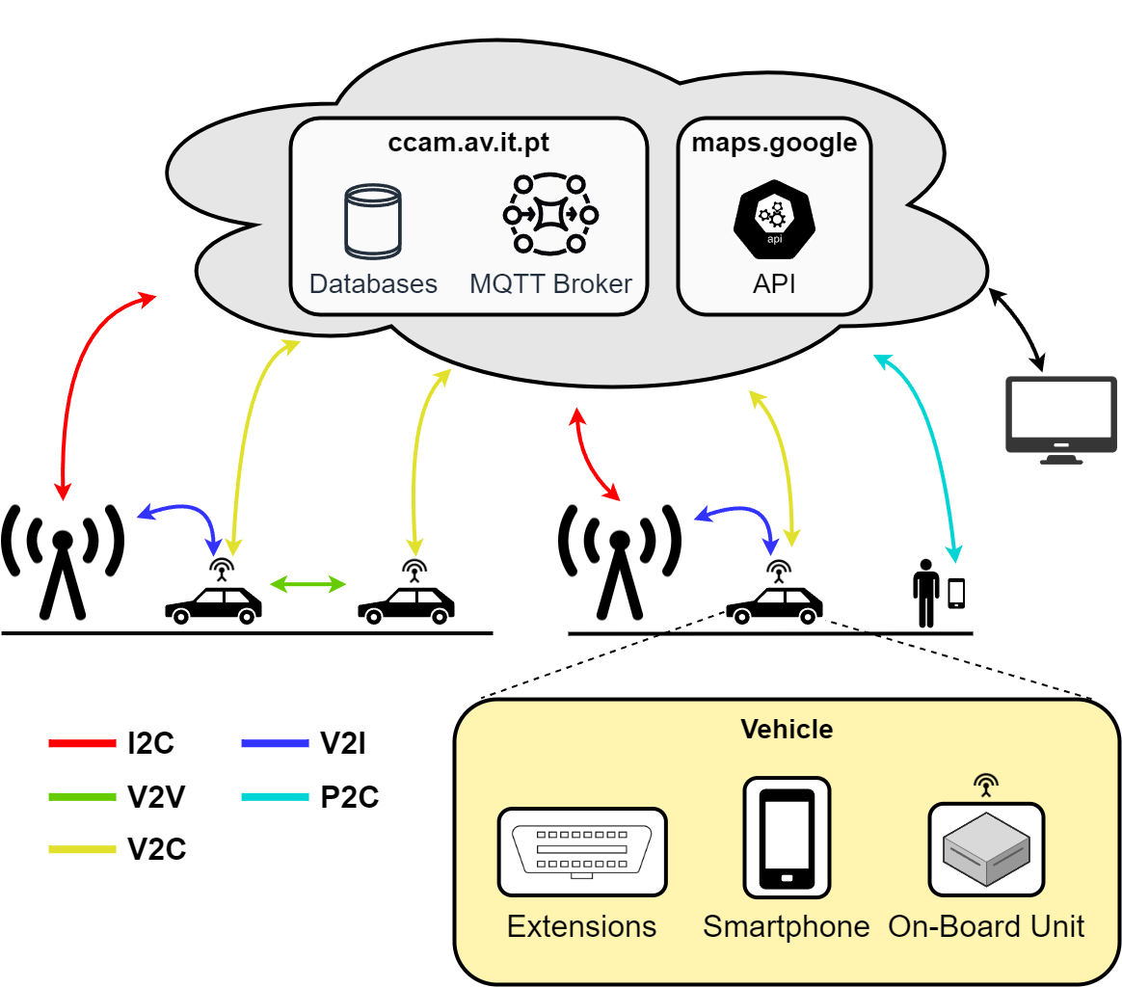
C-ITS Architecture
Notes:
CITS components.
VRU - pedestrian with a phone and app
Vehicle - mobile application connected to na obu

Slide 10

User Modes
Vulnerable Road User (VRU)
Share VRU location in real time
Send and receive road events
Traffic Control Center (TCC)
Monitoring
Send and receive road events
On-Board Unit (OBU)
Access V2X services
Collect sensor data
Send and receive road events
User mode toggle switch
Notes:
The application supports 3 user modes, each with a diferente purpose.
VRU and TCC modes connect to the central information broker while OBU mode connects to the information broker of a vehicle.
VRU mode shares VRUs location, using VAMs, and is able to filter the information received by setting a Quadtree zoom.
TCC mode receive all information and is used to monitor the road environment and to create road and weather events.
OBU mode provides a driver centric mode that receives only the information contextually relevant, has access to V2X services such as tolling and ev charging and to monitor, collect and share sensor data.

Slide 11
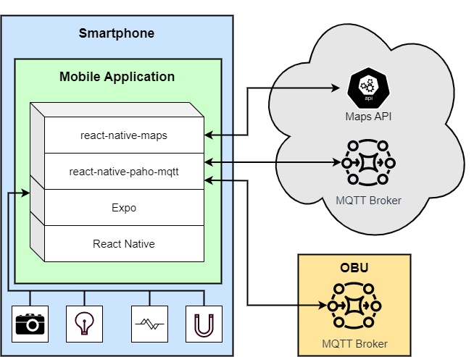
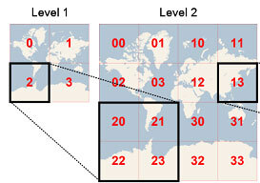
Mobile Application Architecture
Multi platform app
Message Queuing Telemetry Transport (MQTT)
Quadtree (cloud)
Sensor Data Collection
Notes:
App developed with Expo and typescript. Expo is a RN framework which itself is a javascript framwork, based on React, used to create and compile native applications for android, iOS and the web.
Information is exchanged using MQTT brokers, which uses a publish/subscribe architecture. Messages are published on topics that contain the location of the original message encoded in a quadtree which allow subscribers to only receive messages within their location and a defined zoom level.
In OBU mode the application collects data from it’s sensors, including the accelerometer, gyroscope, barometer, magentometer, light sensor and pedometer, and send’s it to the OBU which then combines all sensor data of the application and vehicle into a single message that is then shared to the central broker.

Slide 12
Outline
Introduction
Architecture
Implementation
Mobile application
Message types
Evaluation / Results
Conclusions
Publications and Contributions
Notes:
First I’ll talk about the motivation for this dissertation, the fundamental concepts of C-ITS, the objectives and finally a features comparison of the state of the art mobile applications.

Slide 13
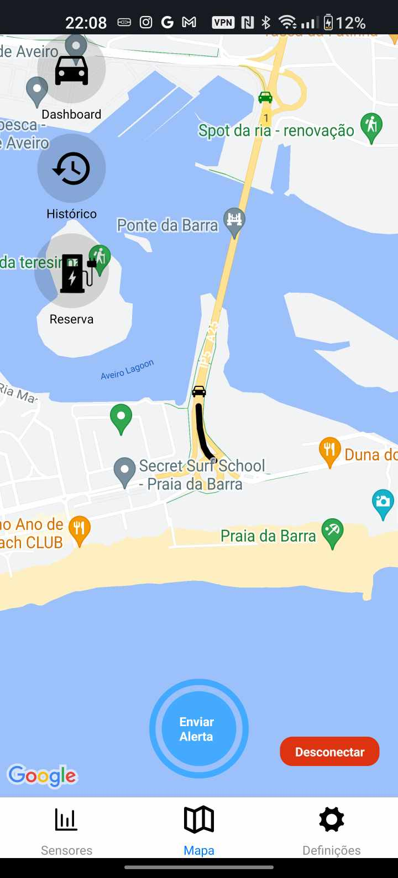
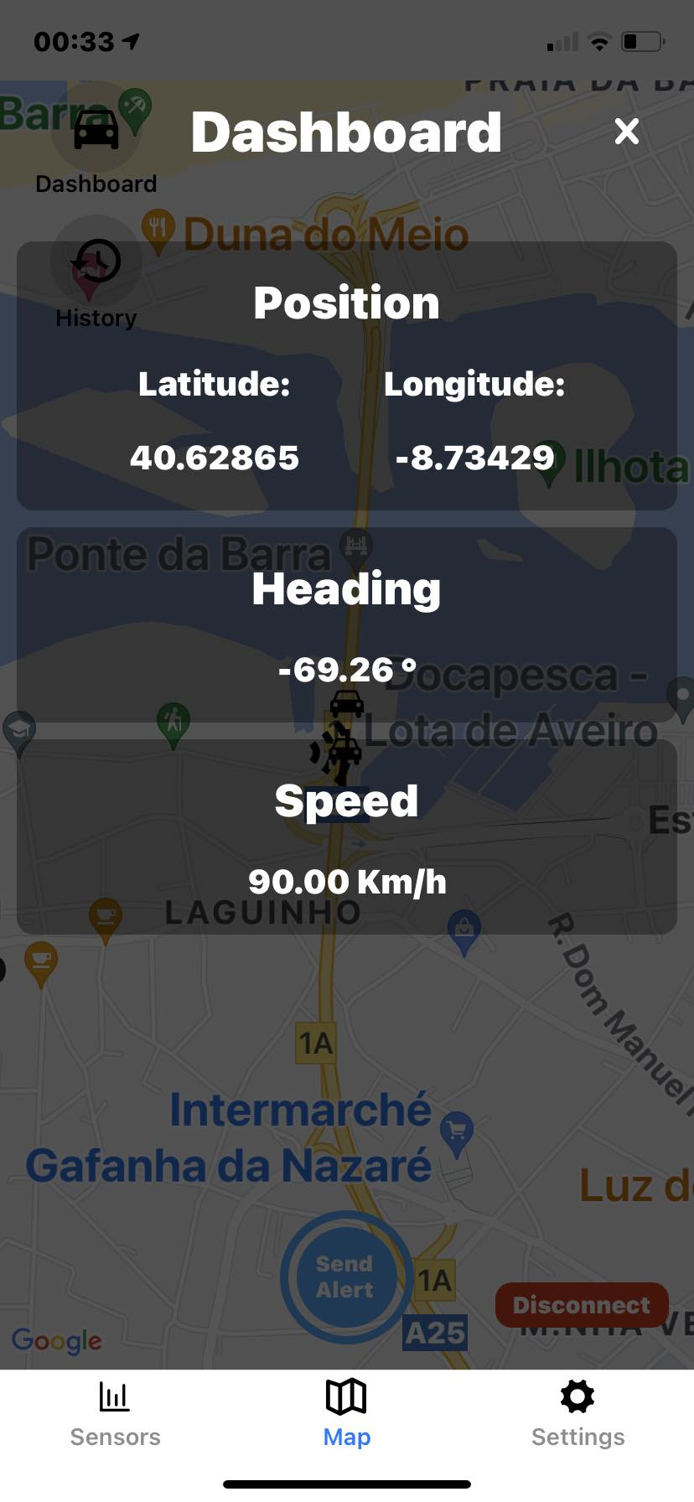
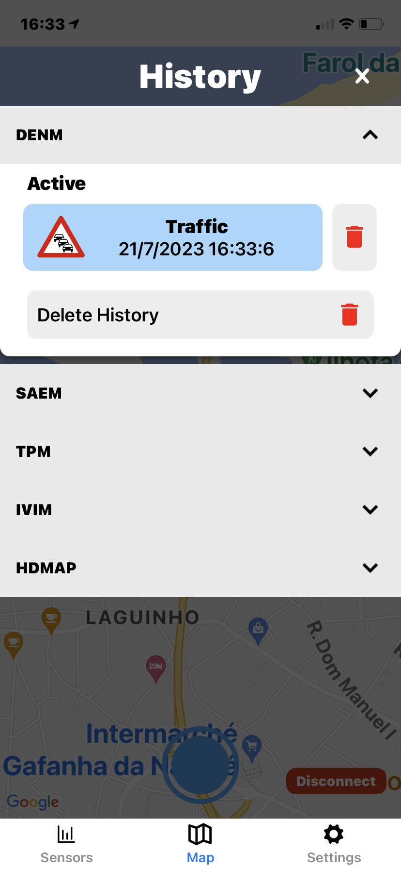

Mobile Application Implementation
Screens
Sensors
Map
Settings
Dashboard
Message history
In-app notifications
Notes:
There are 3 screens
- The sensors screen is used to monitor the sensor data of the smartphone and, when connected, of road vehicles or boats.
- The map screens is where all information shared using messages is displayed and where the user can create road and wheater events and interact with V2X services
- The settings screen is used to customize the connection details, map icons size, quadtree zoom of VRU mode, the period of messages sent and other settings
The application has a dashboard componente that shows information made available by the GPS, a componente for permanent message history and a in-app notification component and queue logic.

Slide 14
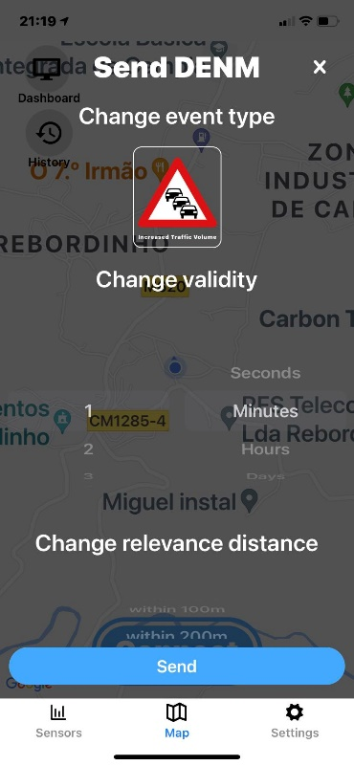
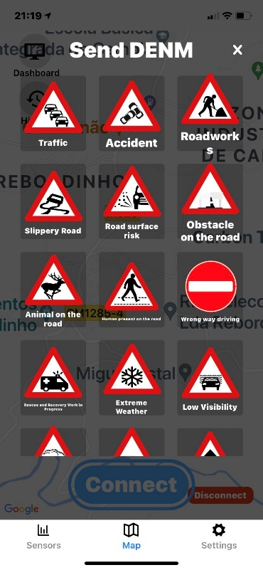
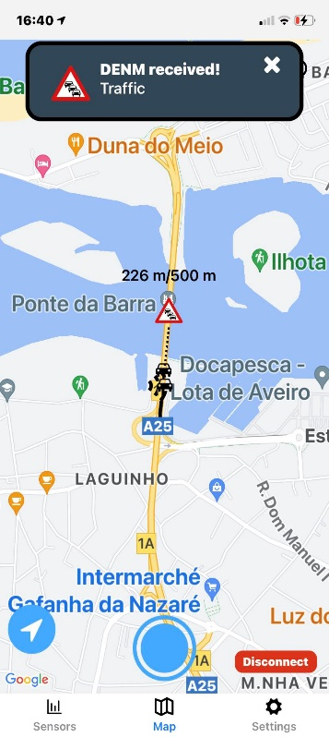
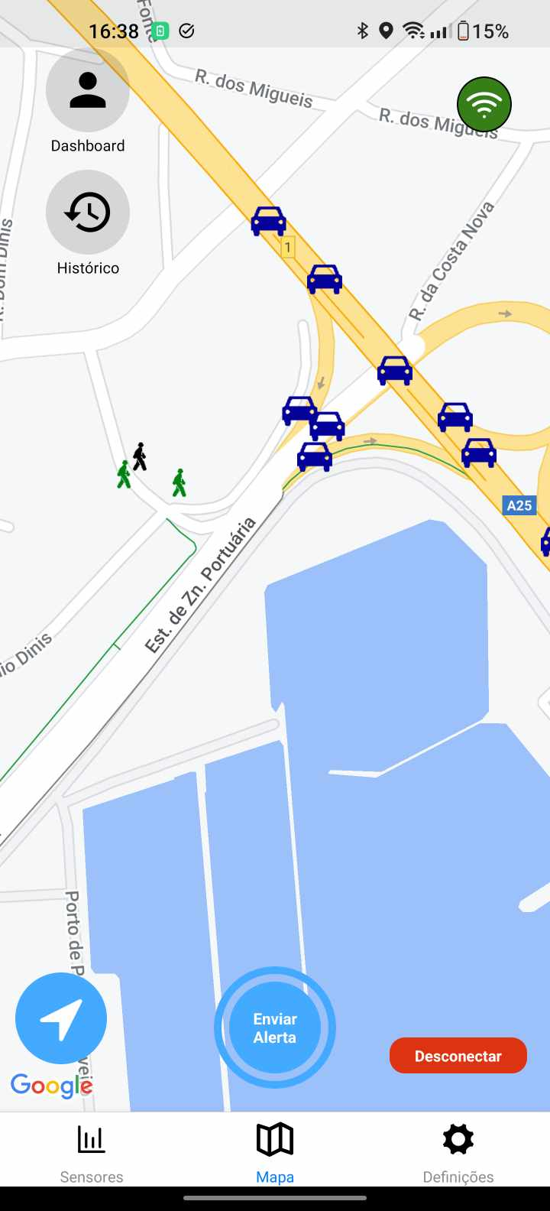
Standard V2X Messages (1/3)
DENM - Decentralized Environmental Notification Message
VAM - VRU Awareness Message
Notes:
DENMs are the messages used to share road and wheater events and are available in all user modes. The application can also be used to update/cancel events created by the user or to negate events created by others.
VAMs are responsible for advertising the location of VRUs and are represented by the stick figure icon.
Denms on the right and vams on the left with distinct text boxes

Slide 15
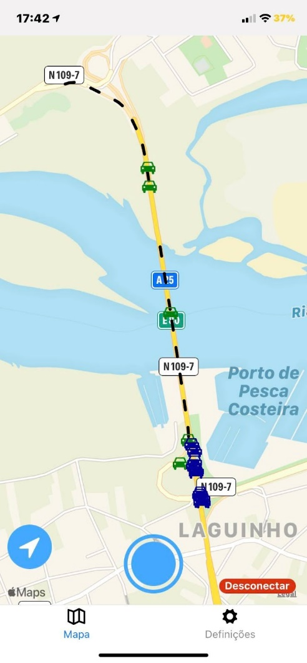
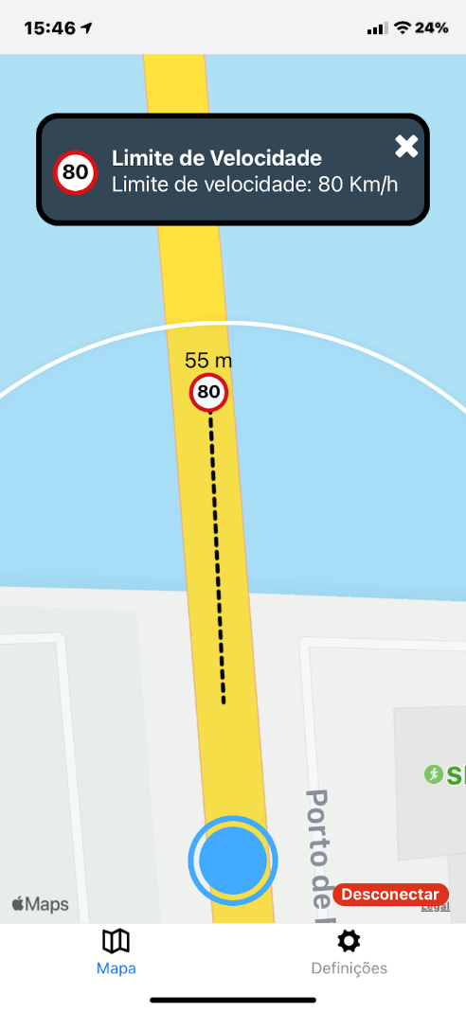
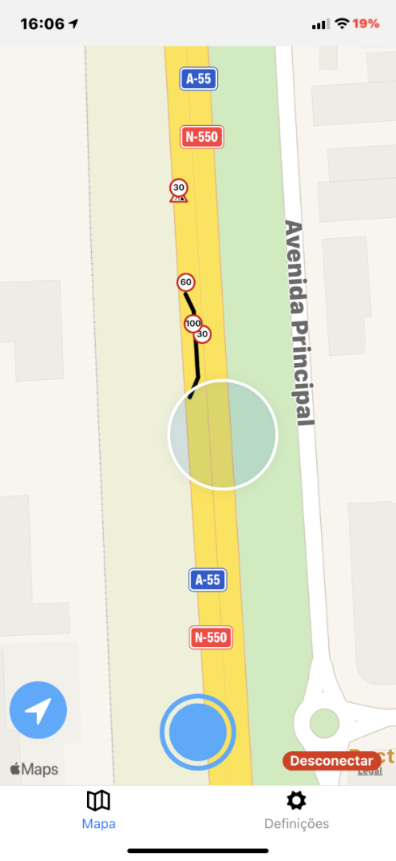
Standard V2X Messages (2/3)
CAM - Cooperative Awareness Message​
CPM - Collective Perception Message
IVIM - Infrastructure to Vehicle Information Message​
HDMAP - ​High-Definition Maps
Notes:
CAMs and CPMs are produced by both vehicles and road infrastructure. CAMs are used to share the location, dynamics and attributes of stations. CPMs are used by stations that have either a radar or a lidar and contain a list of perceived objects with their position and classification.
IVIMs are messages created by the road infrastructure that relate speed limits and text messages to drivers.
HDMAPs are used to communicate complex road scenarios and are of most help for autonomous vehicles in the adaptation to the specific situation.
Make images big and the label shoud have the extended form

Slide 16
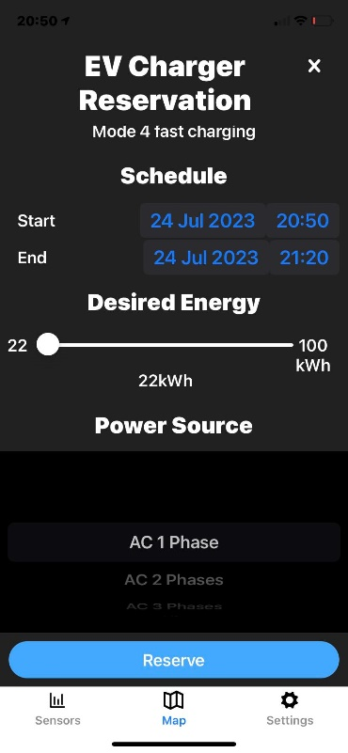
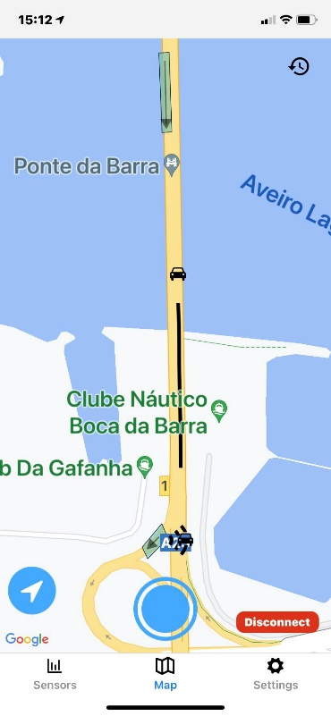
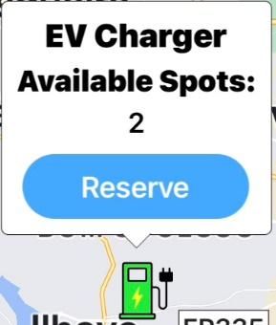
Standard V2X Messages (3/3)
EVCSNM – Electric Vehicle Charging Spot Notification Message
EVRSRM – Electric Vehicle Recharging Spot Reservation Message
SAEM – Services Announcement Essential Message
Notes:
EVCSNM advertisse V2X EV charging stations and includes details about the availability and characteristics of the types of charging supported.
EVRSRM are used to create / update / cancel reservations.
SAEMs are more generic messages focused on V2X service advertisement and are used by the application to receive the location and geometry of tolling zones.

Slide 17
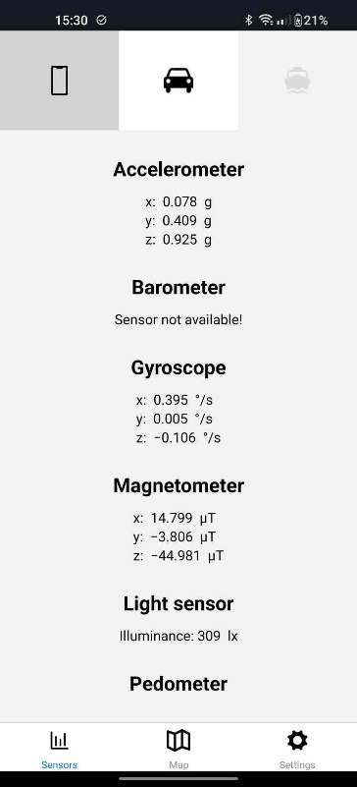
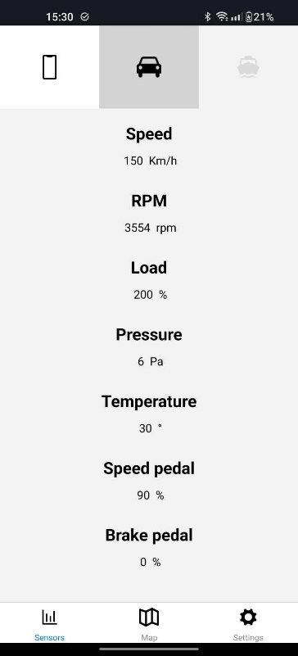
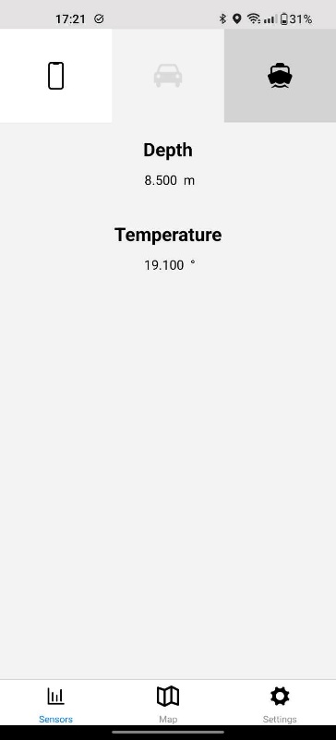
Sensor Messages (Proprietary)
VSM – Vehicular Sensor Message
SPVSM – SmartPhone’s Vehicular Sensor Message
OVSM – OBD-II’s Vehicular Sensor Message
SNVSM – SoNar’s Vehicular Sensor Message (Boats)
Sensor screens
Notes:
While CAMS contain some sensor information such as speed, heading and exterior light status, the vehicle has many more that aren’t part of standardized messages.
SPVSMs contain smartphone sensors, OVSMs contain the sensor data of road vehicle and SNVSM pretend to boats.
VSMs are messages that aggregate the sensor data of one or more of these. The application, while in OBU mode, receives OVSMs/SNVSMs and sends SPVSMs. The vehicle is responsible for creating a VSM with the data from both and forwarding it.
The phone sensors are all in the image of the left and are: accelerometer, barometer, gyroscope, magnetometer, light sensor and pedometer
Images big and the label with the extended form

Slide 18
Outline
Introduction
Architecture
Implementation
Evaluation / Results
Usability
Performance
Sensors
Conclusions
Publications and Contributions
Notes:
First I’ll talk about the motivation for this dissertation, the fundamental concepts of C-ITS, the objectives and finally a features comparison of the state of the art mobile applications.

Slide 19

Usability
Evaluation / Results
Usability
Heuristic Evaluation
Nielsen’s heuristics
Empiric Evaluation
Thinking aloud
Performance
Sensors

Slide 20
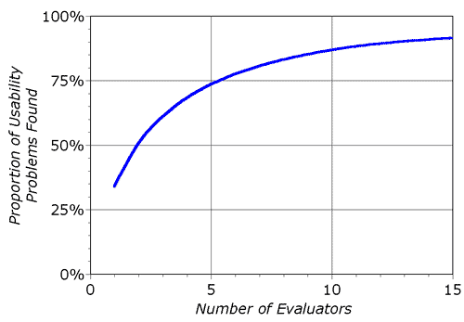
Nielsen’s Heuristics
Evaluators already familiar with the application and its features
10 general heuristics
Problems are classified:
by the heuristic that relates most to it
by severity
Severity | Description
0 | I don't agree that this is a usability problem at all
1 | Cosmetic problem only: need not be fixed unless extra time is available on project
2 | Minor usability problem: fixing this should be given low priority
3 | Major usability problem: important to fix, so should be given high priority
4 | Usability catastrophe: imperative to fix this before product can be released
Ideal number of evaluators – Nielsen group
Severity rating scale – Nielsen group
Notes:
Heuristic evaluation that envolves prople familiar with the application and it’s features. The Nielsehn’s Group specifies 10 general heuristics that can be used to help find and categorize usability problems. The group showed that the number of issues found as a function of the number of evaluators is logarithmic and the recommended amount of evaluators is between 3 and 5. The evaluation was done by 4 people.

Slide 21
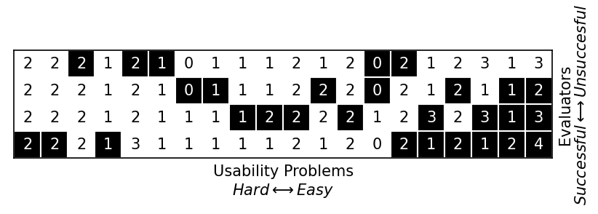
Nielsen’s Heuristics
1st round
Evaluators guide
Find and rate issues
Black squares
2nd round
Rate issues found by others
White squares
Notes:
The evaluators were given a guide that started with the definition of each heuristic, with pratical exemples of issues, and the severity scale used to classify the problema.
Evaluators had a first round of finding and rating usability issues alone. All findings were compiled together into a single document and then evaluators rated the issues they hadn’t found on the first round. Graph of problems found by the evaluators. Squares represent the rating of an evaluator to a given problem. The square is filled with black if the evaluator found the issue on the first round and White otherwise. Problems are considered easier when more evaluators are able to find them on the first round

Slide 22
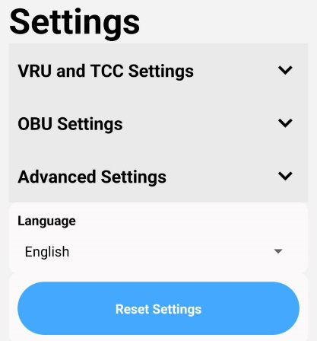

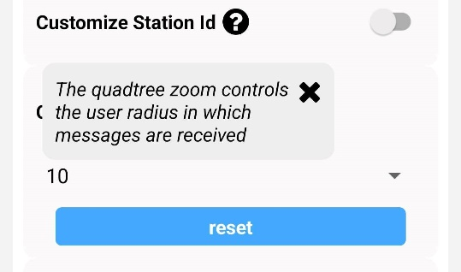
Nielsen’s Heuristics - Results
Problems by severity
4 – Catastrophic
5th – Settings being reset automatically
3 – Major
5th - Blue button to create DENMs had no label
8th - Settings are not organized and it’s hard to find specific ones
2 – Minor
10th – Settings titles aren’t enough to understand what they do
5/20 issues weren’t improved upon

Slide 23
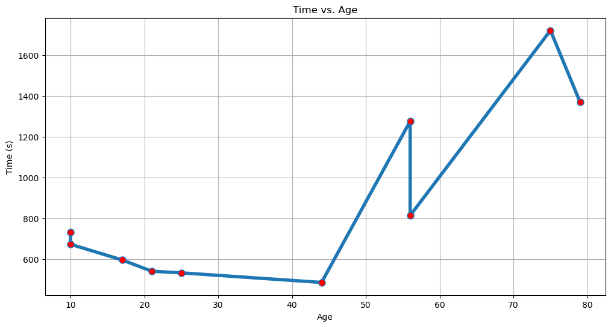
Thinking Aloud
Questionaire based
User
List of tasks with most common use cases
Difficulty rating / long text comment
Observer notes, per task:
Time used
User Comments
Whether the user failed, answered incorrectly, was lost and/or asked for help
Graph of the time to complete the usability test by age (10 - 79)
Notes:
Thinking aloud is na empiric method that envolves two questionaires, one for the observer and another for the user. Users had never used the application and had a list of tasks, commun use cases, to perform and evaluate either in a 1-10 difficulty scale or using long text comments. Observers are instructed to only help when the user explicitly asks for it and they’re responsible for noting the time used, comments and wether the user failed the task, answered incorrectly, was lost and/or asked for help. The evaluation had the participation of 10 users with ages between 10 and 79 years old.

Slide 24
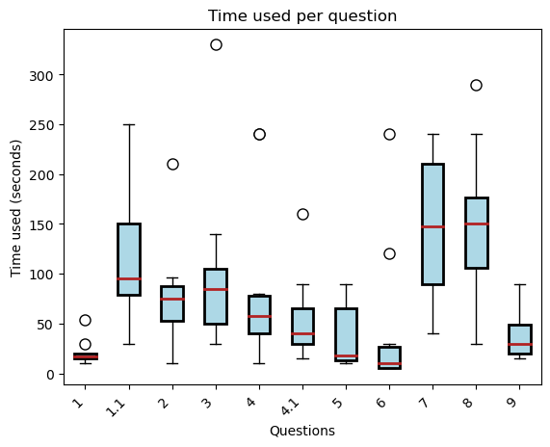
Thinking Aloud - Results
3 - Locate a RSU (Road Side Unit) within the Aveiro district and choose any vehicle perceived by it. What is the speed of the vehicle? How difficult was the task?
Users thought the icon for the RSU was the vehicle
8 - Create an EV charging reservation by selecting one of the available charging station icons on the map. Set the time of arrival to 30 minutes from now and the charging session duration to an hour.
The Android native datetime picker is hard to use
Graph of the time to complete each task.
Notes:
These are exemples of tasks realized and the conclusions taken from the feedback received, chosen by outliers.
The first task was a long text comment response to try to evaluate which settings were not obvious to users and users stated that, even after the improvements done with the heuristic evaluation, most settings were not understandable
The thid task asked users to find a RSU. Most users managed to deduce what the icon represented but some needed help. This issue had also been found in the heuristic evaluation.
The eigth task was to create an EV reservation and the main complaint was about the difficulty of selecting the start and end dates using the native android date picker.
Use only 2 examples

Slide 25
Outline
Evaluation / Results
Usability
Performance
Android Debug Bridge (ADB) monitoring
Network analysis
Test Environments
OBU mode
Simulation of a variable number of CAMs, sent every 100ms
TCC and VRU modes
Simulation of a recording of the central broker with all types of messages
Sensors

Slide 26
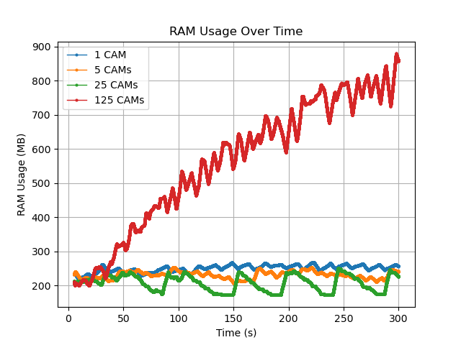
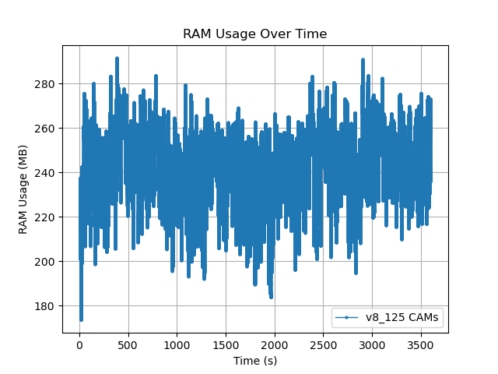
ADB Monitoring
Initial results (5 minutes)
End results (1 hour)
Notes:
The first performance test realized used the Android Debug Bridge. The graph on the left shows the results or RAM usage intially obtained when conducting the test with a variable amount of CAMs and the one on the right represents the final results after some optimizations. It was an incredibly valuable tool to compare the Effect of optimizations on performance.
Next 2 slides should've the title on the left

Slide 27
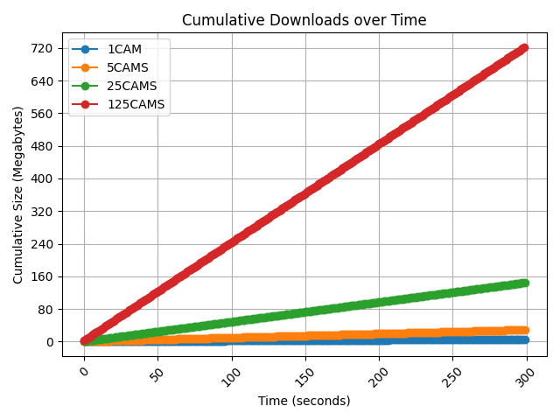
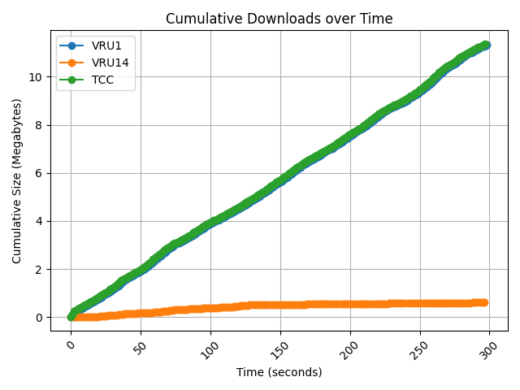
Network Analysis
OBU mode test
TCC and VRU mode test
Notes:
The second performance evaluation was a network analysis that measured the length of the content of messages while assuming that the chars use the ASCII encoding (1 byte per char).
On the OBU mode test, the first graph, the exponential increase of cams is also translated to downloads.
On the TCC and VRU mode, the graph on the left, VRU mode using a quadtree level of 14 the application barely receives any messages (ideal for mobile data plans) while both VRU with quadtree level 1 and TCC received all messages.

Slide 28
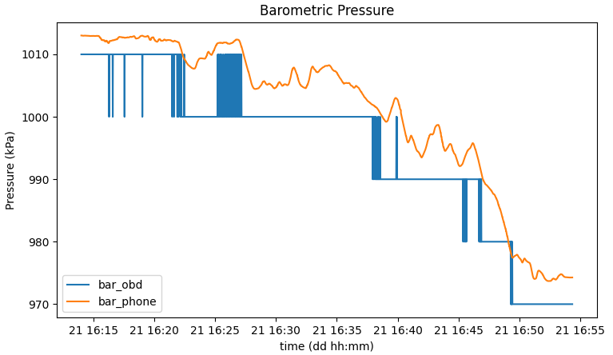
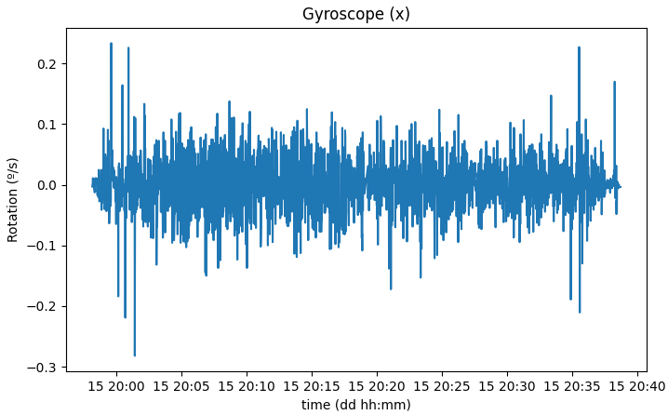
Sensors
Smartphone vs OBU barometer
Speed bump detection using the gyroscope
Notes:
The smartphone has access to many sensors not available on vehicles such as a 3D accelerometer, gyroscope and magnetometer as well as a light sensor and pedometer.
The sensors present on smartphones have na higher precision and sampling rate.
This sensor data can be used to predict road bumps, as shown in the left graph, where speed bumps were present at the beginning and end of the trip. It can also be used to detect the road holes, broken street illumination and risk conditions.

Slide 29
Outline
Introduction
Architecture
Implementation
Evaluation / Results
Conclusions
Publications and Contributions
Notes:
First I’ll talk about the motivation for this dissertation, the fundamental concepts of C-ITS, the objectives and finally a features comparison of the state of the art mobile applications.

Slide 30
Conclusions
State of the art applications
Use proprietary solutions / not standardized
Lack integration with ITS / C-ITS environments and V2X services
Usability issues
Particularly with older generations
Performance
Real time information
Low-end devices
Notes:
See conclusions on the thesis

Slide 31
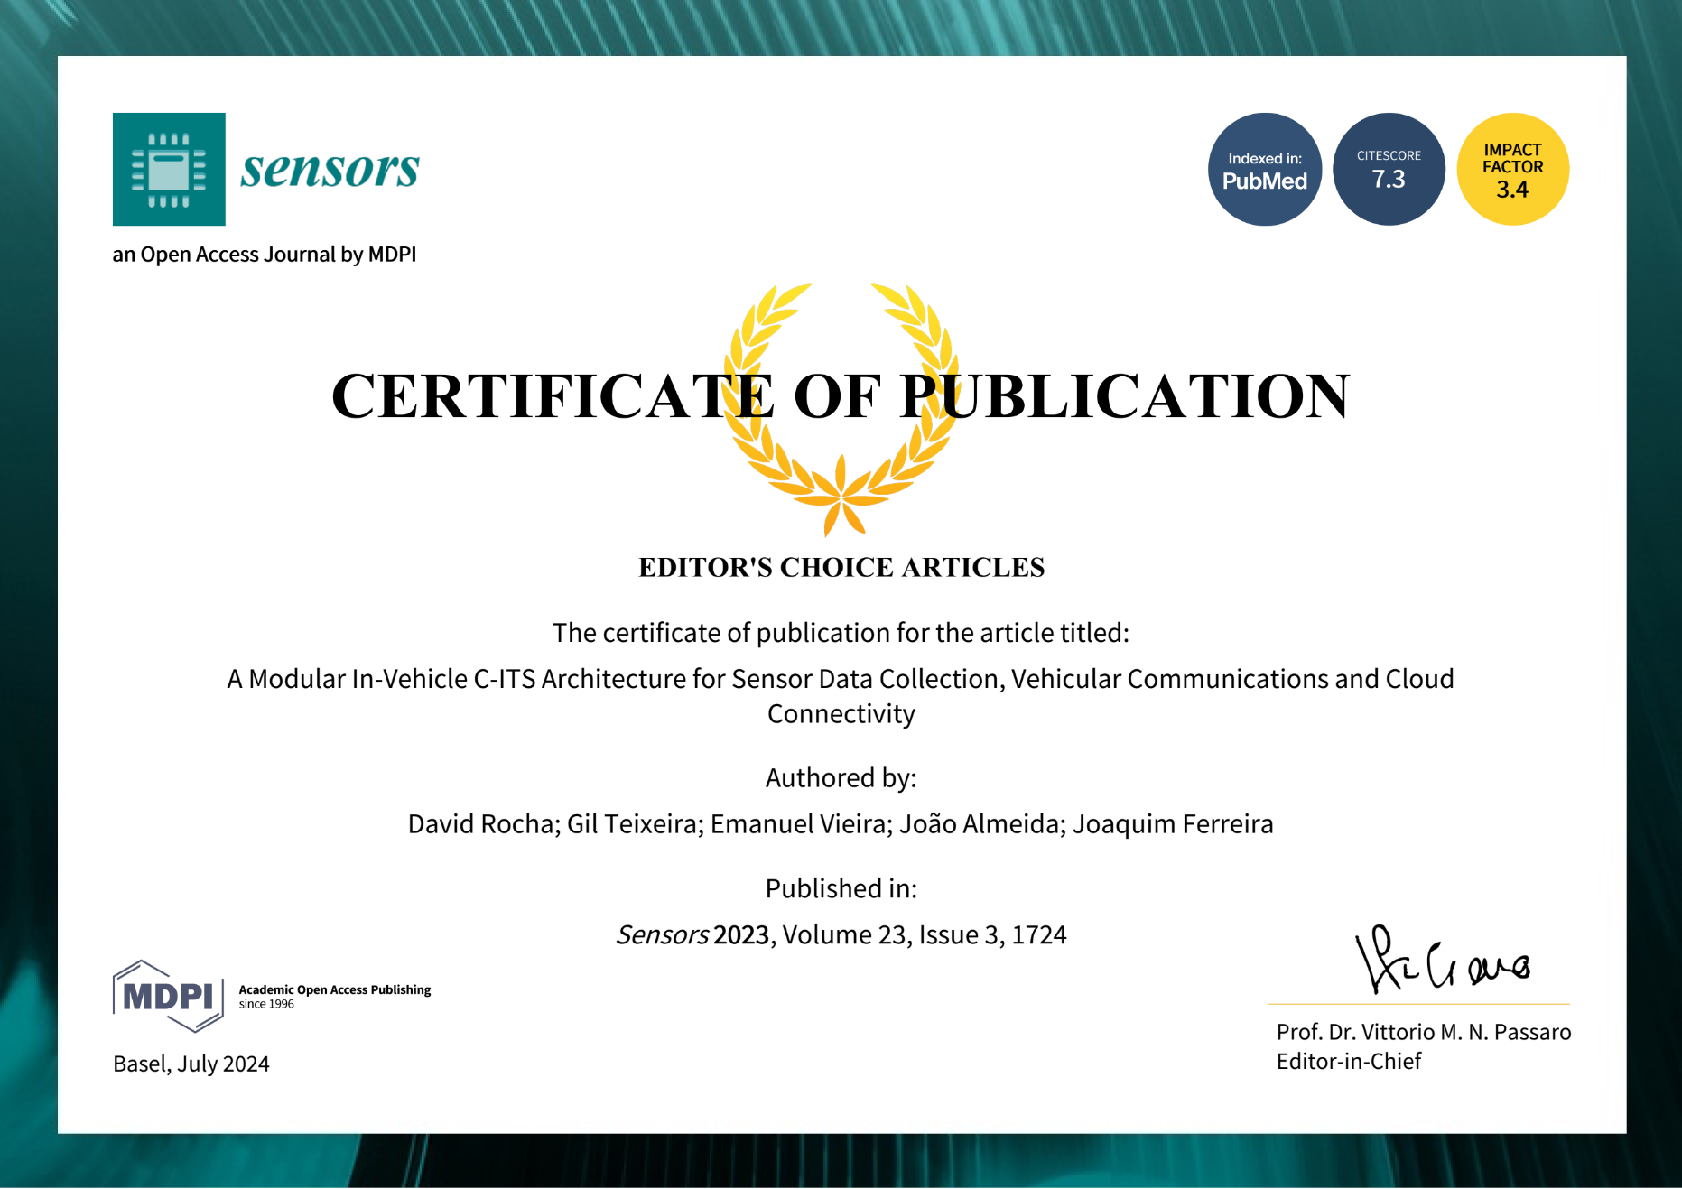
Publications and Contributions
Publications
David Rocha, Gil Teixeira, Emanuel Vieira, João Almeida, and Joaquim Ferreira. 2023. "A Modular In-Vehicle C-ITS Architecture for Sensor Data Collection, Vehicular Communications and Cloud Connectivity", Sensors 23, no. 3: 1724. [1]
Gil Teixeira, David Rocha, Emanuel Vieira, João Almeida, Joaquim Ferreira and José Fonseca. "A Mobile Application for Road Sensing and V2X Services", 29th ITS World Congress, 16-20 October 2023, Suzhou, China [2]
Contributions
Expo - Native implementation of the light sensor on Android - [3]
30.7k Github stars
rn-tri-toggle-switch – general improvements - [4], [5]
4 Github stars
NielsenHeuristicsGraph – python3 script to parse and graph the results of the evaluation – [6]
1 Github star (mine)
Notes:
Two questionaires. 10 users with ages between 10 and 79 Add slide with exemples of tasks

Slide 32


Questions
Application available on:
Android
iOS (soon)
Android Play Store
Apple App Store
Notes:
Two questionaires. 10 users with ages between 10 and 79 Add slide with exemples of tasks

